Slide 1
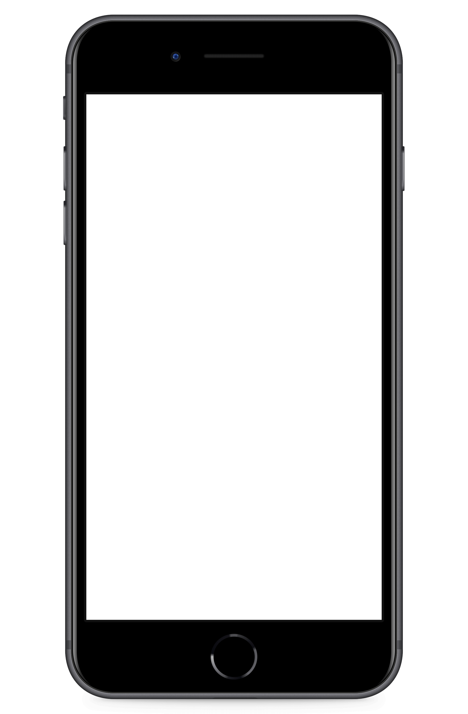
V1 – Low Fidelity

Slide 2
V2 – Mid Fidelity

Slide 3
V3 – High Fidelity Prototype

Slide 4
V1 – Low Fidelity

Slide 5
V2 – Mid Fidelity

Slide 6
V3 – High Fidelity Prototype

Slide 7
V1 – Low Fidelity

Slide 8
V2 – Mid Fidelity

Slide 9
V3 – High Fidelity Prototype

Slide 11


